Slide 1
PROPERTIES OF STOCK OPTIONS

Slide 2
NOTATION
C : American Call option price
P : American Put option price
S_{T} :Stock price at option maturity
D : Present value of dividends during option’s life
r : Risk-free rate for maturity T with cont comp
c : European call option price
p : European put option price
S₀ : Stock price today
K : Strike price
T : Life of option
σ: Volatility of stock price

Slide 3
EFFECT OF VARIABLES ON OPTION PRICING
Variable
c
p
C
P
+
–
+
–
S₀
–
+
–
+
K
?
?
+
+
T
+
+
+
+
σ
+
–
+
–
r
–
+
–
+
D

Slide 4
AMERICAN VS EUROPEAN OPTIONS
An American option is worth at least as much as the corresponding European option
C ≥ c
P ≥ p

Slide 5
LOWER BOUND FOR EUROPEAN CALL OPTION PRICES; NO DIVIDENDS
c ≥ max(S₀ –Ke ^{–rT}, 0)

Slide 6
CALLS: AN ARBITRAGE OPPORTUNITY?
Suppose that
c = 3 S₀ = 20
T = 1 r = 10%
K = 18 D = 0
Is there an arbitrage opportunity?

Slide 7
LOWER BOUND FOR EUROPEAN PUT PRICES; NO DIVIDENDS
p ≥ max(Ke ^{-rT}–S₀, 0)

Slide 8
PUTS: AN ARBITRAGE OPPORTUNITY?
Suppose that
Is there an arbitrage opportunity?
p = 1 | S₀ = 37
T = 0.5 | r =5%
K = 40 | D = 0

Slide 9
PUT-CALL PARITY; NO DIVIDENDS
Consider the following 2 portfolios:
  Portfolio A: European call on a stock + PV of the strike price in cash
  Portfolio C: European put on the stock + the stock
Both are worth max(S_{T} , K ) at the maturity of the options
They must therefore be worth the same today. This means that
c + Ke ^{-rT} = p + S₀

Slide 10
Arbitrage Opportunities
Suppose that
c = 3 S₀ = 31
T = 0.25 r = 10%
K = 30 D = 0
What are the arbitrage possibilities when p = 2.25 ? p = 1 ?

Slide 11
AMERICAN OPTIONS: EARLY EXERCISE
Usually there is some chance that an American option will be exercised early
An exception is an American call on a non-dividend paying stock
This should never be exercised early

Slide 12
AN EXTREME SITUATION
For an American call option:
S₀ = 100; T = 0.25; K = 60; D = 0
  Should you exercise immediately?
What should you do if
  you want to hold the stock for the next 3 months?
  you do not feel that the stock is worth holding for the next 3 months?

Slide 13
REASONS FOR NOT EXERCISING A CALL EARLY (NO DIVIDENDS)
No income is sacrificed
Payment of the strike price is delayed
Holding the call provides insurance against stock price falling below strike price

Slide 14
SHOULD PUTS BE EXERCISED
EARLY ?
Are there any advantages to exercising an American put when
S₀ = 60; T = 0.25; r=10%
K = 100; D = 0

Slide 15
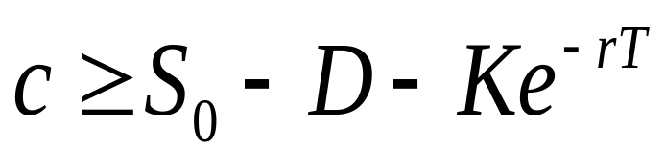
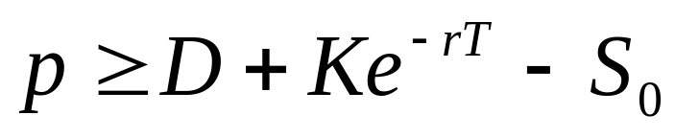
THE IMPACT OF DIVIDENDS ON LOWER BOUNDS TO OPTION PRICES

